Slide 1
Lesson 5a
Chapter 9
Enterprise Applications
Management Information Systems
Usman Ali
dec. 2019

Slide 2
LEARNING OBJECTIVES
How do enterprise systems help businesses achieve operational excellence?
How do supply chain management systems coordinate planning, production, and logistics with suppliers?
How do customer relationship management systems help firms achieve customer intimacy?
Notes:
This chapter looks at enterprise systems, which collect and integrate data from many different departments and systems throughout the business. Ask students to review what operational excellence is. What is customer intimacy and why does this help the business? Have they ever heard of “supply chains” before?

Slide 3
Enterprise Systems
Enterprise systems
  Enterprise resource planning (ERP) systems
  Suite of integrated software modules and a common central database
  Collects data from many divisions of firm for use in nearly all of firm’s internal business activities
  Information entered in one process is immediately available for other processes
Notes:
This slide describes the main purpose of enterprise systems. Ask students for examples of why it might be valuable to have information from one process instantly available to another process.
The text cites the example of Alcoa, which implemented enterprise software to eliminate redundant processes and systems, reduce requisition-pay-to-cycle time, reduce 20 percent of worldwide costs. This illustrates the tremendous value that an effective implementation of enterprise software can have.

Slide 4
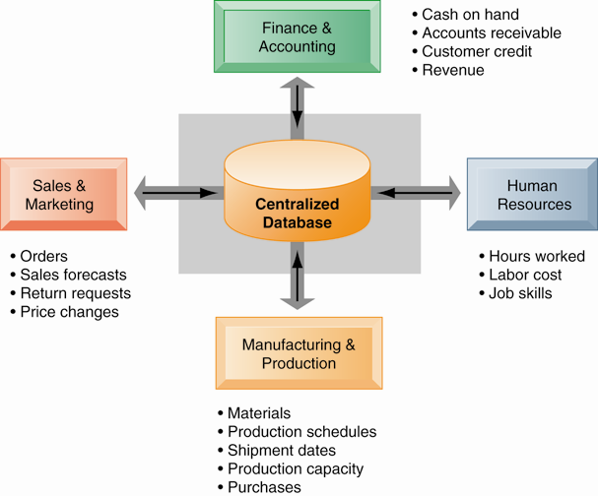
How Enterprise Systems Work
Enterprise systems feature a set of integrated software modules and a central database that enables data to be shared by many different business processes and functional areas throughout the enterprise.
Figure 9-1
Notes:
This graphic illustrates the function of enterprise software to integrate and share data between the different business functions. One of the key ideas of enterprise solutions is that there’s “one company, one database” and not a collection of disconnected databases.

Slide 5
Enterprise Systems
Enterprise software
  Built around thousands of predefined business processes that reflect best practices
    Finance and accounting
    Human resources
    Manufacturing and production
    Sales and marketing
  To implement, firms:
    Select functions of system they wish to use.
    Map business processes to software processes.
      Use software’s configuration tables for customizing.
Notes:
This slide describes the functions in an enterprise software package and how it would be implemented by a firm. Ask students why it is typically best to perform only minimal changes to enterprise software, and instead, change the way the firm works in order to conform to the software’s business processes.

Slide 6
Enterprise Systems
Business value of enterprise systems
  Increase operational efficiency
  Provide firm-wide information to support decision making
  Enable rapid responses to customer requests for information or products
  Include analytical tools to evaluate overall organizational performance
Notes:
This slide discusses the business values of enterprise systems. What does it mean for the firm that enterprise systems enforce the use of common standardized definitions and formats for data by the entire organization?

Slide 7
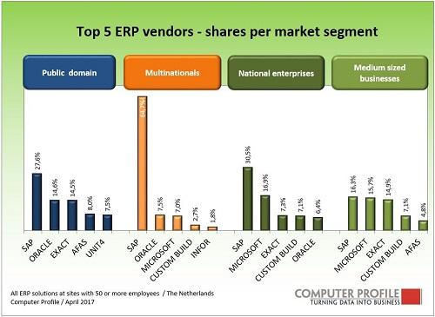
ERP market 2017 Netherlands

Slide 8
What is ERP ?
https://www.youtube.com/watch?v=b3KJkkBs-vs
SAP
www.sap.com
Microsoft Dynamics
https://dynamics.microsoft.com/en-us/

Slide 9
Supply Chain Management Systems
Supply chain
  Network of organizations and processes for:
    Procuring materials, transforming them into products, and distributing the products
  Upstream supply chain:
    Firm’s suppliers, suppliers’ suppliers, processes for managing relationships with them
  Downstream supply chain:
    Organizations and processes responsible for delivering products to customers
  Internal supply chain
    This process involves multiple functions within companies such as sales, production, and distribution.
Notes:
This slide introduces the concept of the supply chain. Supply chain management software is a type of enterprise software for managing complicated supply chains that may include thousands of suppliers.
The text gives the example of Nike’s sneakers’ supply chain. What types of firms are in the upstream supply chain? In the downstream supply chain?

Slide 10
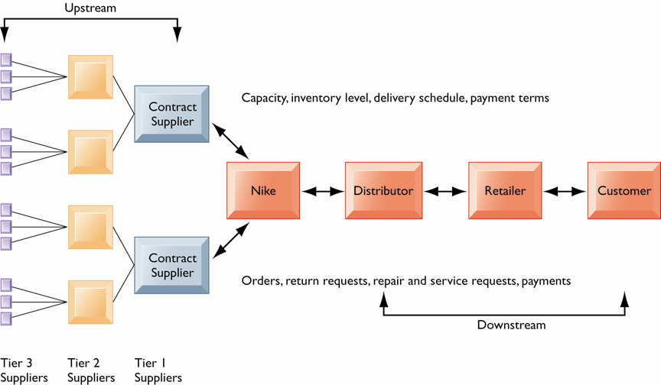
Nike’s Supply Chain
Figure 9-2
This figure illustrates the major entities in Nike’s supply chain and the flow of information upstream and downstream to coordinate the activities involved in buying, making, and moving a product. Shown here is a simplified supply chain, with the upstream portion focusing only on the suppliers for sneakers and sneaker soles.
Notes:
This graphic illustrates the major entities in Nike’s supply chain. Ask students what the difference is between tier 1, 2, and 3 suppliers.

Slide 11
Supply Chain Management Systems
Supply chain management
  Inefficiencies cut into a company’s operating costs
    Can waste up to 25 percent of operating expenses
  Just-in-time strategy:
    Components arrive as they are needed
    Finished goods shipped after leaving assembly line
  Safety stock: Buffer for lack of flexibility in supply chain
Notes:
This slide discusses the effects of timely and untimely information on a supply chain. Ask students what causes inefficiencies in a supply chain (parts shortages, underutilized plant capacity, excessive finished goods inventory, high transportation costs). These are caused by untimely information. Perfect information can result in a just-in-time strategy.
Because of uncertainties, manufacturers keep a safety stock. Why is this an inefficient result? Another effect of uncertainties is the bullwhip effect.

Slide 12
Supply Chain Management Systems
Supply chain management
  Push-based model (build-to-stock)
    Earlier SCM systems
    Schedules based on best guesses of demand
  Pull-based model (demand-driven)
    Web-based
    Customer orders trigger events in supply chain
Notes:
This slide discusses the fact that SCM systems facilitate efficient customer response, allowing the workings of the business to be driven more by customer demand, moving from push-based, sequential models to pull-based, concurrent models of production. Ask students for examples from the text of the pull-based model (Walmart, Dell).

Slide 13
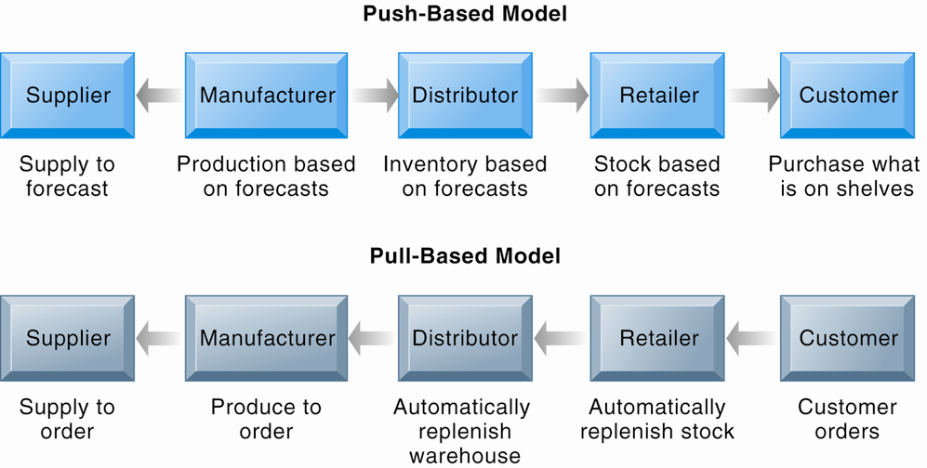
Push- Versus Pull-Based Supply Chain Models
Figure 9-4
The difference between push- and pull-based models is summarized by the slogan “Make what we sell, not sell what we make.”
Notes:
This graphic illustrates the difference between the earlier, push-based model of supply chains to the pull-based model. Ask students if there are some industries uniquely suited to the pull-based model. How about automobiles, appliances, and consumer durables? What are the drawbacks of a pull-based model?

Slide 14
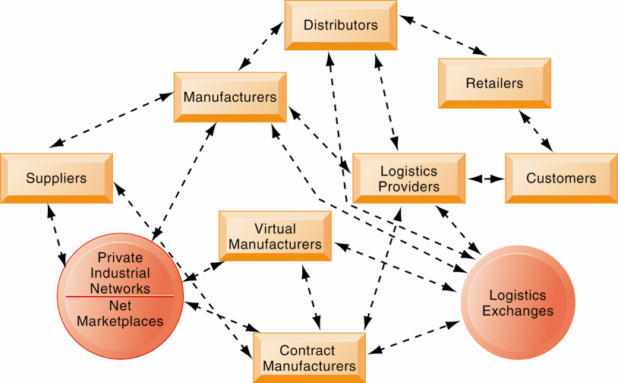
The Emerging Internet-Driven Supply Chain
The emerging Internet-driven supply chain operates like a digital logistics nervous system. It provides multidirectional communication among firms, networks of firms, and e-marketplaces so that entire networks of supply chain partners can immediately adjust inventories, orders, and capacities.
Figure 9-5
Notes:
This graphic illustrates the multidirectional communications within a future supply chain driven by the Internet. Private industrial networks and net marketplaces are discussed in Chapter 10. Private industrial networks are typically a large firm using an extranet to link to its suppliers and other key business partners. Net marketplaces are digital marketplaces based on Internet technology for many different buyers and sellers.

Slide 15
Customer relationship management (CRM)
  Knowing the customer
  In large businesses, too many customers and too many ways customers interact with firm
CRM systems:
  Capture and integrate customer data from all over the organization
  Consolidate and analyze customer data
  Distribute customer information to various systems and customer touch points across enterprise
  Provide single enterprise view of customers
Notes:
This slide introduces the concept of customer relationship management as a key function of the business and the use of CRM systems to provide a single place to consolidate and analyze data about the customer. Ask students to provide examples of the different types of customer data that would be captured by a firm. What types of valuable information does the firm need to know about its customers (most profitable, loyal customers). Have students directly interacted with a CRM? They probably do not know it, but anytime they call into a call center for help they are dealing with some kind of CRM that tracks some or all of their interactions with a firm.

Slide 16
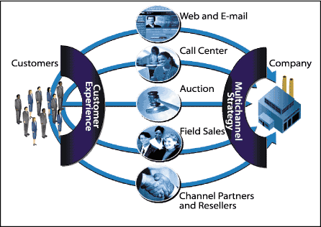
Multichannel approach

Slide 17
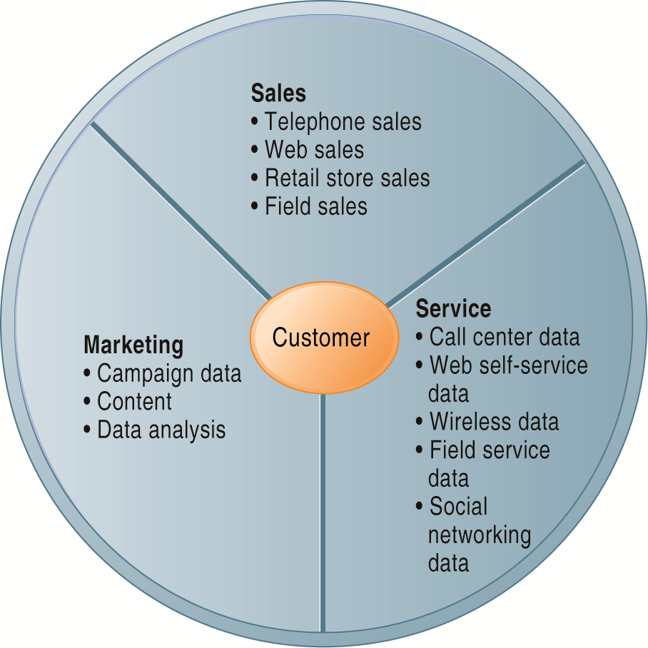
Customer Relationship Management (CRM)
CRM systems examine customers from a multifaceted perspective. These systems use a set of integrated applications to address all aspects of the customer relationship, including customer service, sales, and marketing.
Figure 9-6
Notes:
This graphic illustrates the functions found in the integrated applications of a CRM system.

Slide 18
Customer Relationship Management Systems
  CRM packages typically include tools for:
    Sales force automation (SFA)
      Sales prospect and contact information, sales quote generation capabilities
    Customer service
      Assigning and managing customer service requests, Web-based self-service capabilities
    Marketing
      Capturing prospect and customer data, scheduling and tracking direct-marketing mailings or e-mail, cross-selling

Slide 19
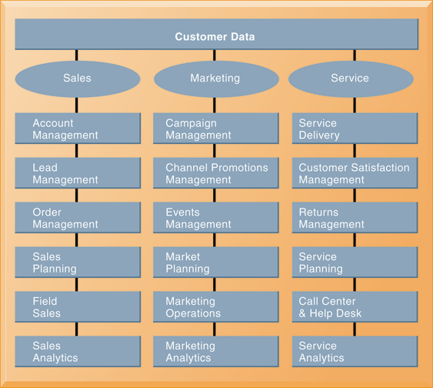
CRM Software Capabilities
The major CRM software products support business processes in sales, service, and marketing, integrating customer information from many different sources. Included are support for both the operational and analytical aspects of CRM.
Figure 9-8
Notes:
This graphic illustrates the range of functions included in the sales, marketing, and service modules in a CRM package. As noted in the text, CRM software is business-process driven, incorporating hundreds of business processes thought to represent best practices in each of these areas. To achieve maximum benefit, companies need to revise and model their business processes to conform to the best-practice business processes in the CRM software.

Slide 20
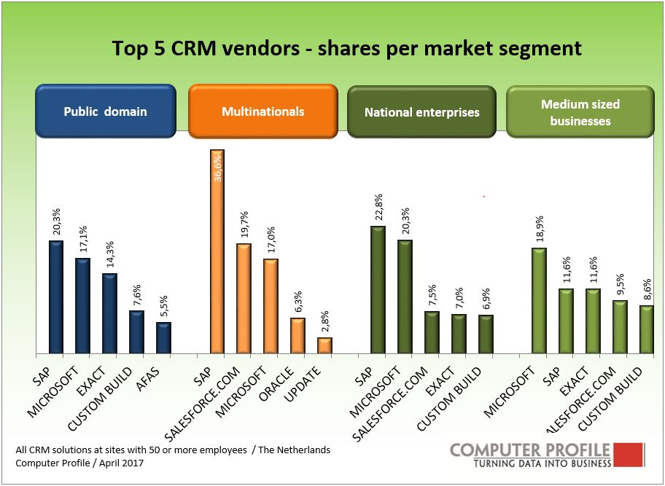

Slide 21
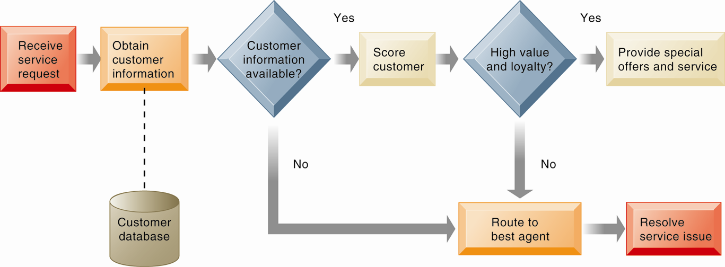
Customer Loyalty Management Process Map
Figure 9-9
This process map shows how a best practice for promoting customer loyalty through customer service would be modeled by customer relationship management software. The CRM software helps firms identify high-value customers for preferential treatment.
Notes:
This graphic illustrates how a best practice for increasing customer loyalty through customer service might be modeled by CRM software. What kinds of information might indicate that a customer is loyal or high value?

Slide 22
Customer Relationship Management Systems
Operational CRM:
  Customer-facing applications such as sales force automation, call center and customer service support, and marketing automation
Analytical CRM:
  Based on data warehouses populated by operational CRM systems and customer touch points
  Analyzes customer data (OLAP, data mining, etc.)
Notes:
This slide discusses the two main types of CRM software—operational and analytical. Ask students how the CLTV is calculated (it is based on the relationship between the revenue produced by a specific customer, the expenses incurred in acquiring and servicing that customer, and the expected life of the relationship between the customer and the company.)

Slide 23
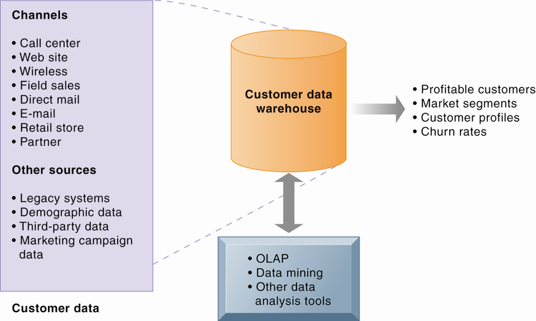
Analytical CRM Data Warehouse
Analytical CRM uses a customer data warehouse and tools to analyze customer data collected from the firm's customer touch points and from other sources.
Figure 9-10
Notes:
This graphic illustrates the main components of analytical CRM. Data is captured from various channels and fed into a customer data warehouse, where OLAP, data mining, and other analysis tools help identify profitable customers, churn rates, and so on.

Slide 24
Customer Relationship Management Systems
Business value of CRM systems
  Increased customer satisfaction
  Reduced direct-marketing costs
  More effective marketing
  Lower costs for customer acquisition/retention
  Increased sales revenue
Notes:
This slide discusses the value to businesses of implementing a CRM system. How would marketing be made more effective by using a CRM system?

Slide 25
Enterprise Applications: Challenges and Opportunities
Enterprise application challenges
  Highly expensive to purchase and implement enterprise applications (ERP, CRM, SCM)
  Technology changes
  Business process changes
  Organizational learning, changes
  Switching costs, dependence on software vendors
Notes:
This slide looks at the challenges firms face when they implement enterprise applications. Ask students to explain and apply with examples the concept of “switching costs.” What problems could result from being dependent on a single software vendor?

Slide 26

Short break
10 min.
after the break :
sign the attendency list
Ch 10 E-commerce

